Slide 1
SHANTHI JEEVAN EVANGELICAL MISSION

Slide 2
WHAT WE BELEVE
We believe in the Triune God of the Bible, who exists eternally in three persons -- Father, Son and Holy Spirit.
We believe the Bible is the written word of God accurate and fully authoritative in all it says. Through the Bible God reveals the meaning of life and the way to authentic faith.
We believe God created mankind in His image to enjoy perfect companionship with God. Disobedience to God's authority destroyed that companionship creating a void in the human heart. This void can only be filled by a repaired relationship with God made possible by Jesus' sacrifice.
We believe the Church is the community of all who believe on Jesus Christ - the living presence of Jesus in the world proclaiming His good news and transforming the world by its presence, service and love for others.

Slide 3
VISION AND MISSION
Our vision is for every 5 years setting a base – a mission field in the unreached area.
Every 10 years build a church in those unreached area
So after 30 years of ministry in Dharmapuri district, Tamilnadu 4 church has been planted. In which 1st church was handed over to Methodist church of India.
Wholistic Evangelism.

Slide 4
FAMILY FAITH STATEMENT
Our family wants to reach the unreached by living a life honoring god and helps needy in every way we can.
HOW TO REACH:
Tracts distribution/ literatures/ Christian books/ biographies
Sharing gospel One to one / group
Sharing the word @ Sunday service
-Sunday classes
- PLHA Gathering
- Guest Lectures
- Tuition centers
- Tailoring Units.
- Computer Center.
- Bible College
- Special Gatherings – youth/ couples / pastors meet
-Awareness Programs.
- videos/ film shows
- paper cuttings – Real position of the world
- Referrals - Christian/ Government / private Hospitals.
- career Guidance
- Admission in Hostels / Homes

Slide 5
B) People Group Unreached:
villages, school, college, students, youth/ uneducated/ educated/ leaders of the religious activists/ laborers/ who come to seek help.
HOW?
House Visits/ Counseling/ Group Meetings/ Personal witness.
RESULTS:
People will come to now the lord
People will be connected with God.
People will bear fruits.
People will lead a life example to others.
People have faith in external life.
Changes in people’s life.
Share the word – spread the gospel.
Gods name be glorified.

Slide 6
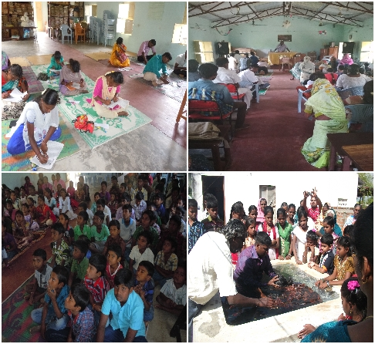
KOTTAIBYRAHALLI BASE
Every Sunday we have worship service.
Every 1st Sunday Dharmapuri PLHA gathering is being conducted.
Distribution of Tracts, Bibles, Christian Education Books etc
Special gatherings like youth meet/children’s meet etc
Every 2nd Saturday Bible College is being conducted
Once in a month Master of Ministry course is being conducted
Computer class and tailoring class is conducted
Twice in a year free medical camp is conducted.

Slide 7
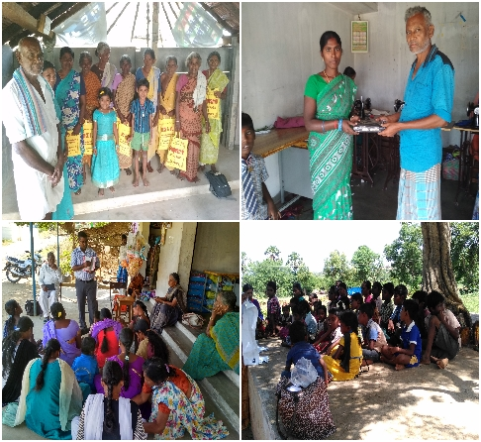
SELLAMUDI BASE
Missionary is appointed, he is doing Evangelism
Sunday worship.
He has started 6 Sunday class centers, regular follow up is going on.
V.B.S conducted in 9 villages.
Free tailoring unit.
Adult literacy class.

Slide 8
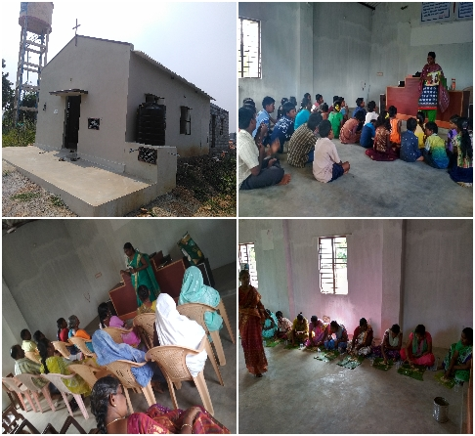
VELLAKKAL BASE
Sunday service
Free medical camp
Outreach
free tailoring classes from April -2016.
Free tuition center for childrens from oct – 17

Slide 9
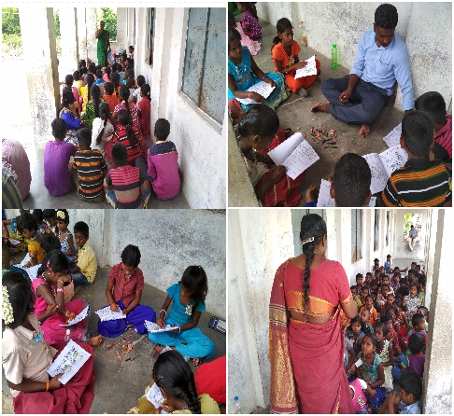
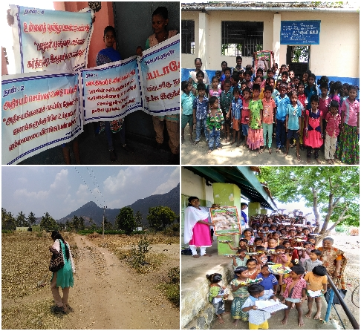
VOCATIONAL BIBLE SCHOOL
Every year VBS is conducted. We used to reach 1500 children in more than 30 centers
Last year new 3 places VBS was conducted . In these paces VBS never conducted before. So children enjoyed their first experience VBS.

Slide 10
PLHA GATHERING- Patients Living with Hiv Aids(PLHA)
We conduct plha gathering in 9 places of 6 districts (vellore, Dharmapuri, Namakkal, Salem, Trichy, Krishnagiri) of Tamilnadu.
Once in a month PLHA’s gather in their nearby places for fellowship and to hear the gospel. 8 Churches have given their places to conduct these gatherings.
We provide nutrition packets , give diet counseling, sex counseling, spiritual counseling, educational support, career guidance etc. PLHA’s share their experiences and encourage one another.
Since we conduct the gathering in churches so there will no stigma and discrimination. 8 PLHA are taking communion along with our church members. Our church members and PLHA’s prepares lunch and have good fellowship.

Slide 11
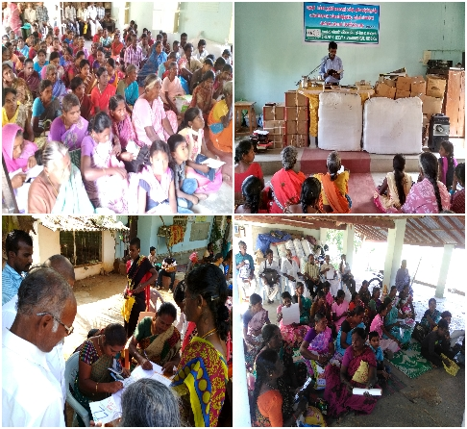
DHARMAPURI PLHA GATHERING
Every 1st Sunday PLHA(Patient Living With HIV AIDS) in and around dharmapuri district gather in our church.
Share gospel, counseling, supports will be given.
Special gathering for youth has been conducted.

Slide 12
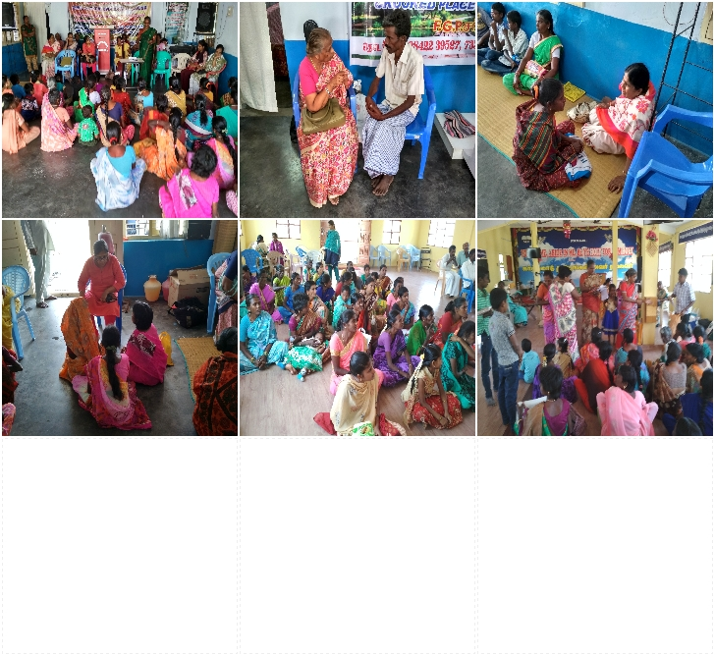
PLHA GATHERING
Every 1st Saturday - Tripatur PLHA gathering in New Life Church- 70 families will attend ( velore district)
Every 1st Sunday – dharmapuri Plha gathering in our church Church- 100 families will attend (dharmapuri district)
Every 2nd Sunday – Namakkal plha gathering in AG church Church- 150 families will attend (namakkal district)
Every 3rd Saturday – Krishnagiri plha gathering in CPM church Church- 70 families will attend (krishnagiri district)
Every 3rd Sunday – salem plha gathering in an independent church Church- 100 families will attend (salem district
Every 4th Wednesday- Hosur PlHA gathering Church- 50 families will attend
Every 4th Saturday – Musiri PLHA gathering Church- 100 families will attend (trichy district)
Every 4th Sunday – cm pudur PLha gathering - Church- 20 families will attend

Slide 13
HOUSE VISITS
We do house visit of needy believers, cancer patients, terminally ill patients.
Preparing them for Eternal life is the purpose of most of the House Visits.
Needed counseling will be given.

Slide 14
GUIDANCE TO SCHOOLS
Dharmapuri is the most backward district in Tamilnadu.
From 1988 we are finding free education for school children's.
Namely,
Calvary chapel trust is having free hostel and schooling facilities for plha children.
For others in tirunelveli, bangalore many hostels are offering free education, we guide them to these schools.
Many came into Christ and many got into government jobs, many became engineers, nursing students…
In Bangalore hostel students were well equipped

Slide 15
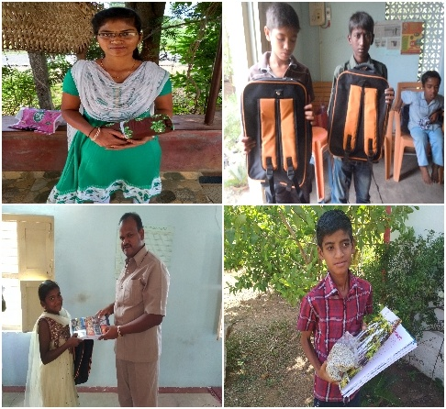
MERCY MINISTRY
EDUCATIONAL SUPPORT
NUTRITIONAL SUPPORT
TAPPING GOVERNMENT RESOURCES
Referral
Advocacy
Networking and Partnership.

Slide 16
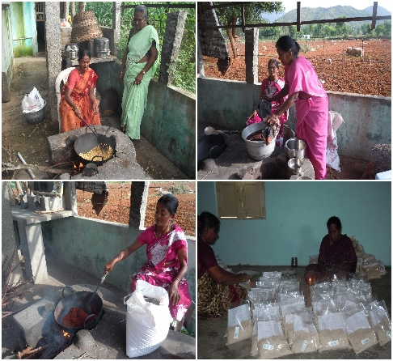
PREPARATON OF NUTRITION PACKETS
Nutrition packets for PLHA’s, Cancer Patients is being prepared and given.

Slide 17
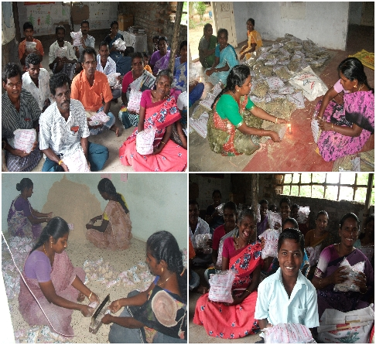
NUTRITION PACKETS

Slide 18
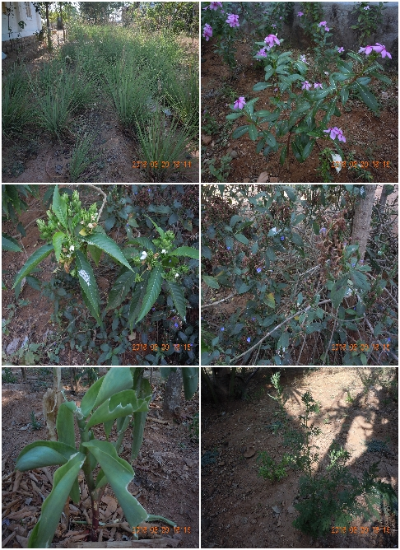
HERBAL GARDEN
We have Herbal Plants like papaya, drumstick, Artemisia, lemon grass, insulin, aadathodai, thulasi dates etc.
People are make use of these herbals.

Slide 19
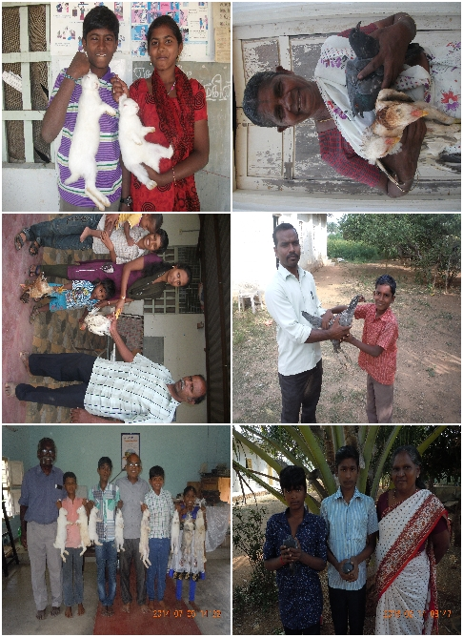
PET ANIMALS
We rear pet animals like Rabbits, Goats, Chickens, pigeon.
To be given to PLHA’s for their income generations.

Slide 20
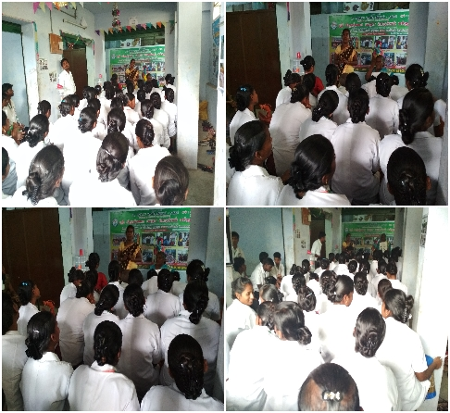
AWARENESS PROGRAMS
Awareness program is conducted among school children, college students etc
Need:
sexual morality among Youth/ Children are decreasing. So they need to be given awareness about HIV and how to protect them from Child Abuse by teaching them Good touch and Bad touch.

Slide 21
BIBLE COLLEGE
As most of the independent pastors have no theological background we want to equip them. So in partnership with Goodnews Baptist bible college we have study center in KottaiByrahali
About 40 are attending in every second Saturday.
Resource persons are coming to take classes every month
We offer all these free of cost as most of them could not afford for it.
We also afford them food in the afternoon, PLHA’s and church members help us to prepare food for the pastors.

Slide 22
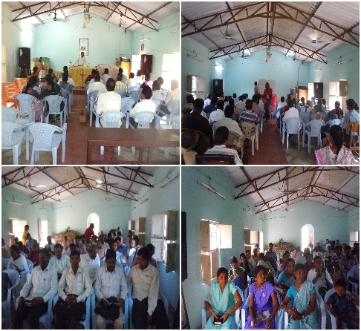
BIBLE COLLEGE PHOTOS

Slide 23
LOVE FEAST
Every month three fellowship feast is being arranged
Every first Sunday we have feast for PLHA gathering (100 to125)participants
Every second Saturday for bible col1ege students (30-40)leaders/pastors
Third for master of Ministry course(40-60)participants.
Apart from these we have love feast on special gatherings like youth meetings, special trainings...

Slide 24
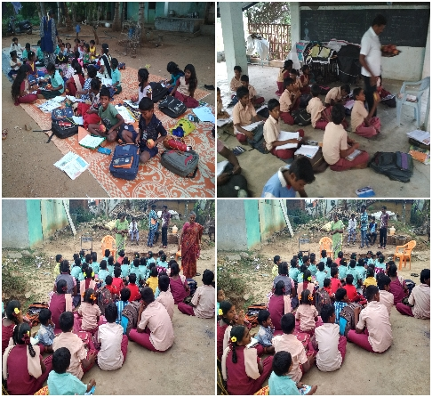
TUITION CENTERS
2 tuition centers are being conducted in 2 villages.
Many children are getting benefitted
We also teach them one verse for a week.
2 centers through EL- SHADAI Trust and 1 center through SEM

Slide 25
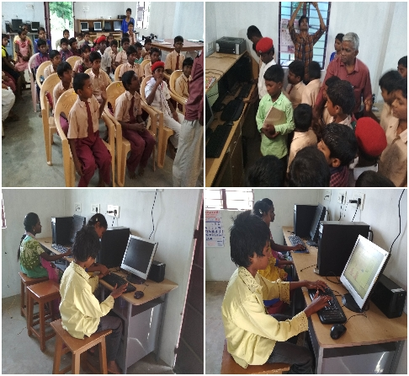
COMPUTER CENTER
This is the first batch started with the help of EL- SHADAI Trust
47 students attended this training. 22 students have completed the course successfully.

Slide 26
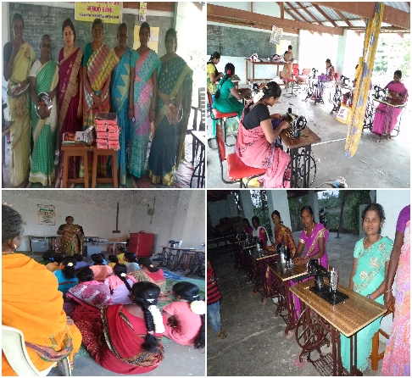
TAILORING UNIT
Tailoring unit has been conducted in 5 centers
110 students have trained in kottaibyrahalli center.
Many are going to Garments, some started stitching in their house and getting income out of it.
Kottaibyrahalli center
Boovalmaduvu center
Moongilmaduvu center
Sellamudi center
Poochoor center

Slide 27
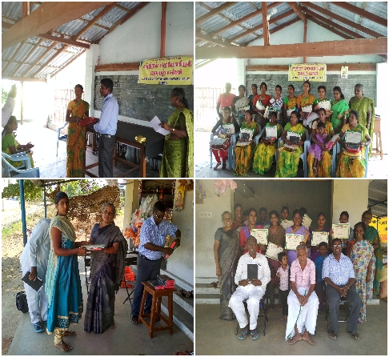
TAILORING UNIT
Tailoring machine is given to the needy students who cannot able to buy the machine.
For four months tailoring classes is conducted for free for women and certificate is given to students with one tamil bible.
Along with tailoring classes we also share gospel and also teach one bible verse a week.

Slide 28
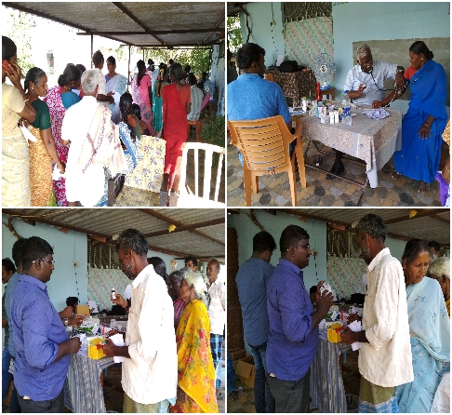
MEDICAL CAMPS
Medical camps has been conducted twice a year.
Through which we share the gospel with the locals.

Slide 29
Pray for our ministry

Slide 30
Thank you

